Slide 1

Überblick Microsoft Cloud Adoption Framework
Secure

Slide 2
Plan
An iterative process that supports your business … as it evolves
Govern
Manage
Define strategy
Adopt
Ready

Slide 3
Microsoft Cloud Adoption Framework for Azure
Security is a discipline you practice along your entire cloud adoption path
Define strategy
Define motivations, and create a business case leveraging cloud economics
Plan
Create actionable cloud adoption plan aligned to the strategy
Ready
Prepare cloud environments with Azure landing zones
Adopt
Migrate or Innovate
Design, build and deploy workloads to Azure
Ready
Prepare cloud environments with Azure landing zones
Security is a critical design area here
Govern
Automate governance baseline and empower delegated responsibility
Govern
Automate governance baseline and empower delegated responsibility
Manage
Build operations baseline and support enterprise operations
Manage
Build operations baseline and support enterprise operations
Secure
Establish security baseline and manage security posture
Security is a discipline of governance & automated guardrails
Security drives your operations baseline implementation
All of which depend on sound security posture management

Slide 4
Secure

Slide 5




Security guidance
CEO
Securing digital transformation
Business leadership
Business and security integration
CIO
CISO
Technical leadership
Security strategy, programs, and epics
Initiative planning/execution
Microsoft cybersecurity reference architectures (MCRA)
Cloud Adoption Framework (CAF)
Zero Trust
Privileged Access
Azure Top 10
Architecture and policy
Ransomware
Architects and technical managers
Technical planning
Microsoft security documentation
Azure Security Benchmark
Implementation
Product docs Azure | Microsoft 365
Well-Architected Framework (For Azure workload owners)
Implementation
May 2021 https://aka.ms/MCRA
Feedback and additional resources:
https://aka.ms/markslist
@MarkSimos

Slide 6


Cloud Adoption Framework – Secure methodology End state for managing your overall security posture
Business alignment
Business alignment
Establish cross-org processes to scale cloud security throughout your business
Secure
Risk insights
Integrate security insights into risk management framework and digital initiatives.
Security integration
Integrate security insights and practices into business and IT processes
Operational resilience
Ensure organization can operate during attacks and rapidly regain full operational status.
Security disciplines
Security disciplines
Implement proven security processes built on modern, cloud-based security tools
Access control
Establish Zero Trust access model. Extend modern protection to legacy assets.
Security operations
Detect, respond, and recover from attacks; hunt for hidden threats; lead through data-driven decision
Asset protection
Protect sensitive data and systems. Continuously discover, classify & secure assets.
Security governance
Continuously identify, measure, and manage security posture to correct deviation and reduce risk.
Innovation security
Integrate security into DevSecOps processes. Align security, development, and operations practices.
Cloud security team
Establish team with expertise and experience for security and cloud. Often a cross-functional security team(s) that includes members of security team, cloud center of excellence (CCoE), Cloud operations, IT operations, and others.

Slide 7
Access control Simplify security—and make it more effective
Classic approach Restrict everything to a secure network
Zero trust Protect assets anywhere with central policy

Slide 8
Security baseline: Get started

Slide 9
Accelerate security with native tools
Business alignment
Secure
Risk insights
Integrate security insights into risk management framework and digital initiatives.
Security integration
Integrate security insights and practices into business and IT processes
Operational resilience
Ensure organization can operate during attacks and rapidly regain full operational status.
Security disciplines
Azure AD
M365 Defender
Azure Firewall
Azure RBAC & ABAC
Azure DDoS
Azure Web Application Firewall
Azure AD B2B
Azure AD B2C
Azure Bastion
Azure Lighthouse
Directory Federation
Directory Replication Azure Networking
Azure Portal
Subscription Design
Hybrid Identity
Management Groups
PrivateLink
Access control
Establish Zero Trust access model. Extend modern protection to legacy assets.
Security operations
Detect, respond, and recover from attacks; hunt for hidden threats; lead through data-driven decision
Asset protection
Protect sensitive data and systems. Continuously discover, classify & secure assets.
Security governance
Continuously identify, measure, and manage security posture to correct deviation and reduce risk.
Innovation security
Integrate security into DevSecOps processes. Align security, development, and operations practices.
Azure Defender
Azure Sentinel
M365 Defender
Azure Blueprints
Azure Policy
Microsoft Defender for Cloud
Azure Networking
Azure Storage
Encryption
Management Groups
Microsoft Defender for Cloud
Azure Blueprints
Azure Policy
Azure RBAC & ABAC
Secure Score
Compliance Dashboard
Resource Locks
Azure DevOps
GitHub Advanced Security
Resource Manager Templates
Azure Automation
API Management Gateway
Azure DDoS
Azure Web App Firewall
Azure Site Recovery
Azure Backup

Slide 10
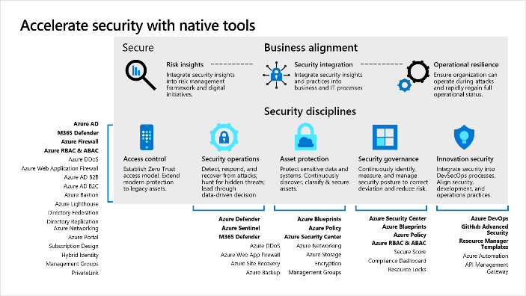
Establish a security foundation
Don’t try to learn every security tool today. Take a balanced approach to implementation—audit, learn, then apply.
Security foundation
Start small. Establish processes that quickly evolve as cloud adoption and cloud security mature.
Improve your security posture based on risks identified in the cloud adoption plans.
Continuous improvement
As additional iterations of cloud adoption are planned, the risk profile will change.
Incrementally expand processes for each security discipline, which will require expertise in additional tools.

Slide 11
What makes a good security foundation?
Built for scalability
Secure by design
Accounts for governance
Well defined networking design
Fully understood and controlled permissions and identities
No standing access ever
Deployed through Infrastructure as Code
The state of the MVP is always known and controlled with approvals

Slide 12

Getting started
Deploy the Azure landing zone accelerator
Implement Azure security services
Rich, mature, scaled-out implementation
4 implementations: Start small to Enterprise-scale
Includes full set of products and controls
Intended to get organizations to security at scale, quickly
Customizable implementation
Deploy through portal or integrate with GitHub
Opinionated guidance based on best practices and lessons learned
Deployment includes:
Dedicated subscriptions for specific functions (optional)
Management Group structure
Network topology (hub and spoke or vWAN)
Azure Policy – enforcement options
Azure Firewall (optional)
Microsoft Defender for Cloud
Azure Defender (optional)
Azure Sentinel (optional)
Azure Network Security Groups (optional)
Azure Monitor (Log Analytics, Audit Logging)
Small footprint, starter feature-set
Develop and iterate at your own pace
Work with partners to customize the iterations, based on your specific requirements (e.g. scale-out, or enhanced policy controls)
Deployment includes:
Quickstart: Microsoft Defender for Cloud
Web Application Firewall deployment tutorial
Deploy and configure Azure Firewall Premium
Manage Azure DDoS Protection Standard using the Azure portal
Overview of the Azure Security Benchmark V2
CIS Microsoft Azure Foundations Benchmark v1.3.0 blueprint sample
Azure Security Benchmark blueprint sample overview
Cloud Adoption Framework - Security Methodology
Enterprise-Scale/policies.json

Slide 13
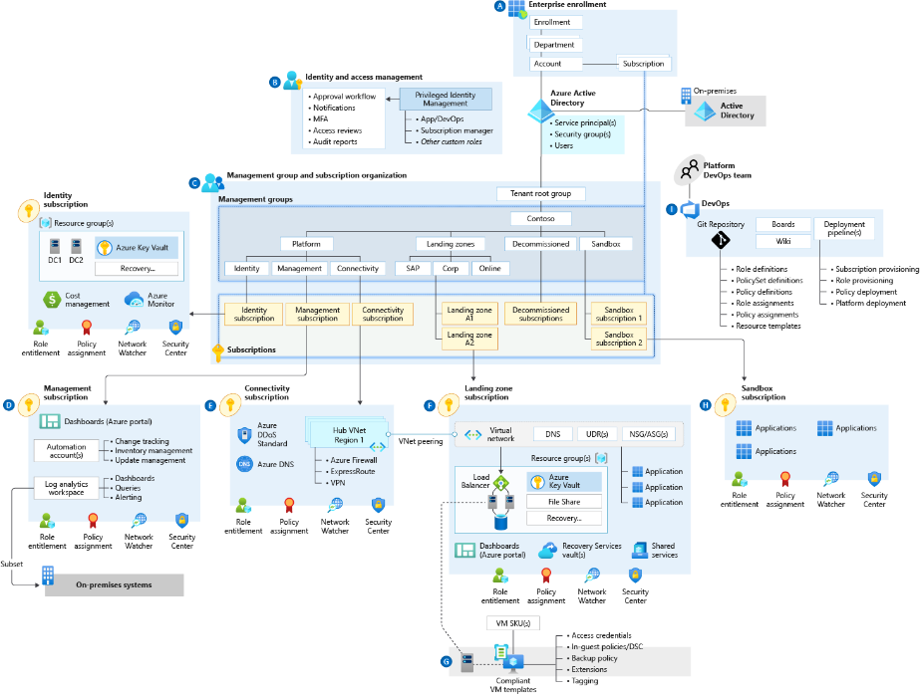
Azure landing zones (including security)
The Azure landing zone accelerator provides a full implementation—
the complete architecture, with foundational security tools
Best practice Include security tools with Azure landing zone architecture provides:
Target end-state for most organizations
Scaled out, mature environment
Broad range of Microsoft best practices for Azure environment design
Strong foundation for organizations to establish consistent management, governance and security processes

